Slide 1
Decarbonizing German Road Freight Transport: Challenges and Measures
La décarbonation des mobilités vue du cœur de l’industrie automobile allemande - Mission d’étude en Allemagne
Özcan Deniz (German Aerospace Center, Institute of Vehicle Concepts)
Fraunhofer IAO Stuttgart, 28.06.2023

Slide 2
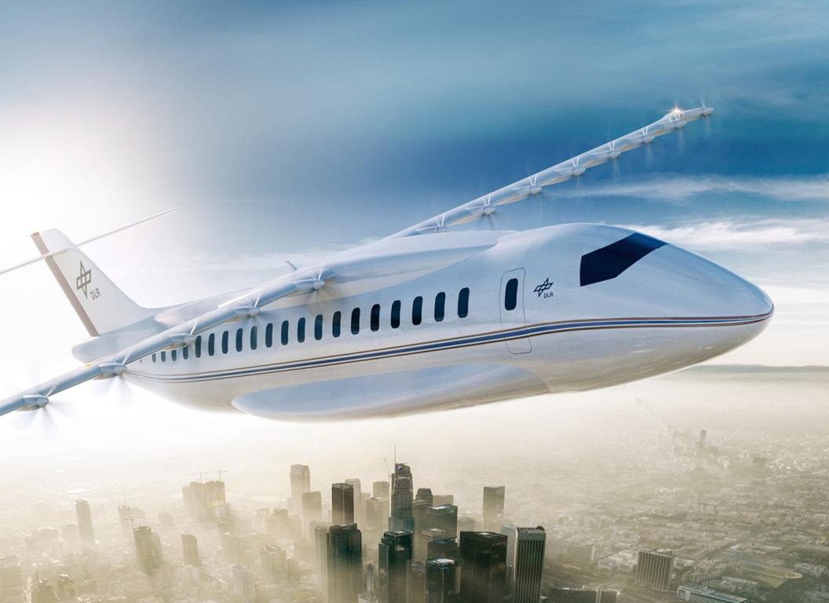
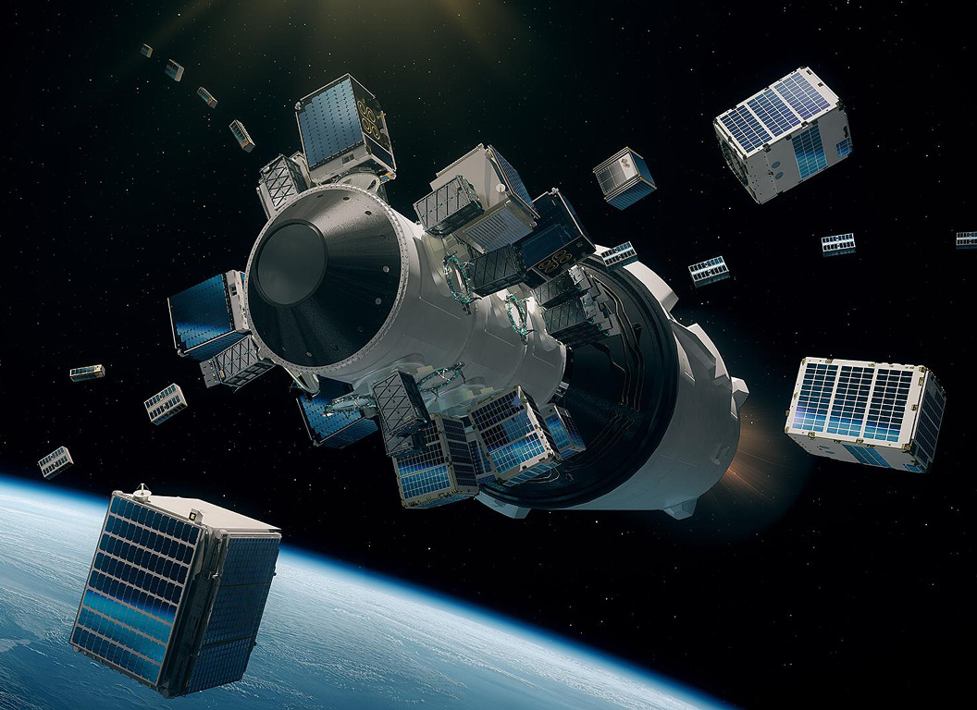


Fields of activity of the German Aerospace Center
Aeronautics and aerospace
Energy and transport
Digitisation and security
Planning and implementation of German aerospace activities
Project executing agency for research funding

Slide 3


PRESENT THROUGHOUT GERMANY
Brussels
Washington
Tokyo
Stade
Bremerhaven
Neustrelitz
Hamburg
Braunschweig
Oldenburg
Berlin
Bremen
Cochstedt
Trauen
Göttingen
Hannover
Cottbus
Zittau
Jülich
with more than
10,000 employees
at 30 locations
Dresden
Köln
Jena
Bonn
Rhein-Sieg-Kreis
Ulm
Augsburg
Lampoldshausen
Oberpfaffenhofen
Stuttgart
Weilheim

Slide 4



DLR Institute of Vehicle Concepts
We think ahead on these topics
Road transport
Road vehicles and digital systems
Transport management
Rail transport
Rail vehicles and infrastructure
Traffic management
Transport system
Transport development and impact
Urban mobility and development
Intermodal transport hubs
DLR = „Deutsches Zentrum für Luft- und Raumfahrt“

Slide 5
Outline
Current challenges and opportunities for decarbonizing road freight transport
Scenario analysis of the market potential of alternative powertrains in commercial vehicles: Results of the BEniVer* research project
Insight into DLR´s vehicle concept “U-Shift”
*Begleitforschung Energiewende im Verkehr Accompanying research on the energy transition in transport)

Slide 6
Development of the German Freight Transport
+40%
+65%
-23%
-13%
- 90%
→ Freight structure and logistics effects supported the growth of road freight vehicles over other transport modes
→ Road freight transport became more efficient through incremental technologies, rail freight transport through direct electrification
→ Although vehicles have become more efficient, the absolute Co2 emissions in (road) freight transport have increased.
Source: DLR – Daten und Fakten: Güterverkehr

Slide 7
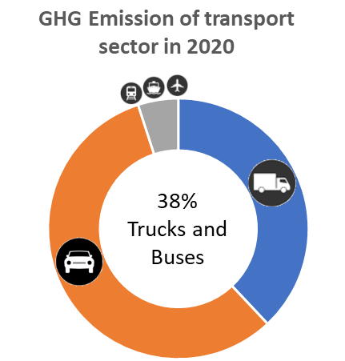
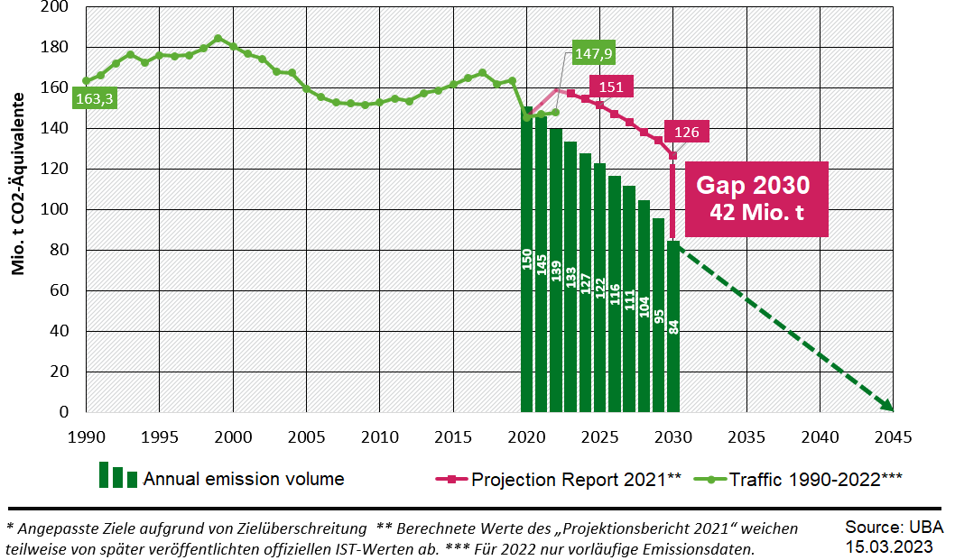
Target of GHG emissions in the german transport sector (Climate Protection Act)
The Federal Climate Protection Act (KSG) sector target for 2030 is -48% vs. 2019, from 164 (2019) to 85 (2030) Mt CO2 eq.
Overall, GHG emissions are to be reduced by 65% from 1990 levels by 2030.
The goal is complete decarbonization or GHG neutrality by 2045.
Reformed act of 2023: One common target for all sectors, no individual sector targets in 2030
Source: Klimaschutz im Verkehr | Umweltbundesamt

Slide 8
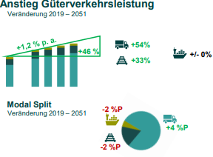
Moderate growth in freight transport performance
Forecast of the Ministry of Transport
Increase in freight transport performance
change 2019-2051
Freight transport will continue to increase. The highest growth is expected to be in road transport.
This results in a change in the modal split in favour of road freight transport, while rail and inland waterways are losing ground.
Modal split
change 2019-2051
Source: PowerPoint-Präsentation (bund.de)

Slide 9
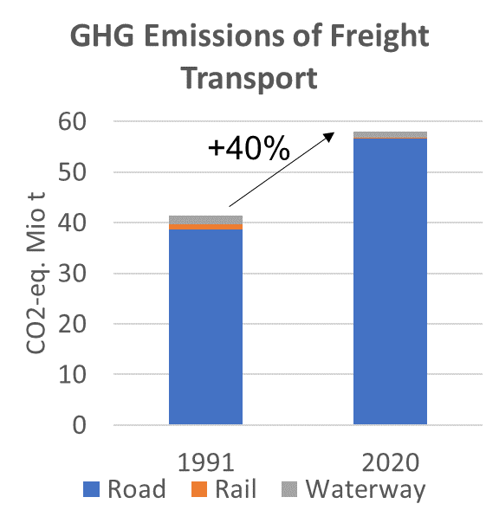
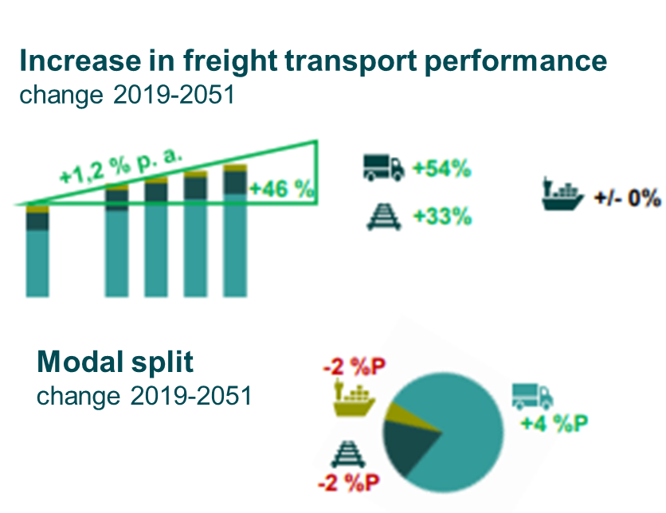
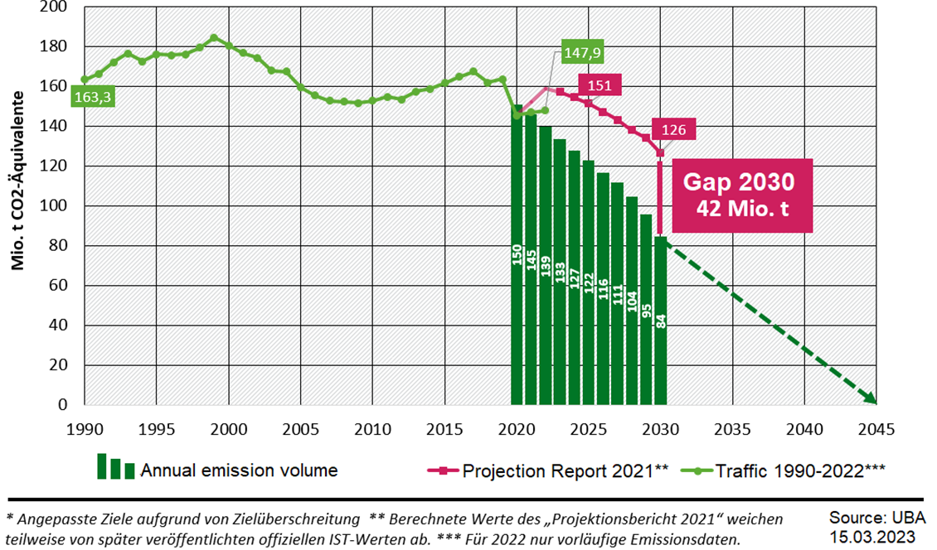
Challenge to decarbonise road freight transport
Increased GHG emissions
Tight Targets for GHG emission reductions
Increasing demand for road transport forecast
The key challenge for the road freight sector is to significantly reduce GHG emissions with increasing transport demand
Notes:
Energy efficiency is key measure to climate neutrality

Slide 10
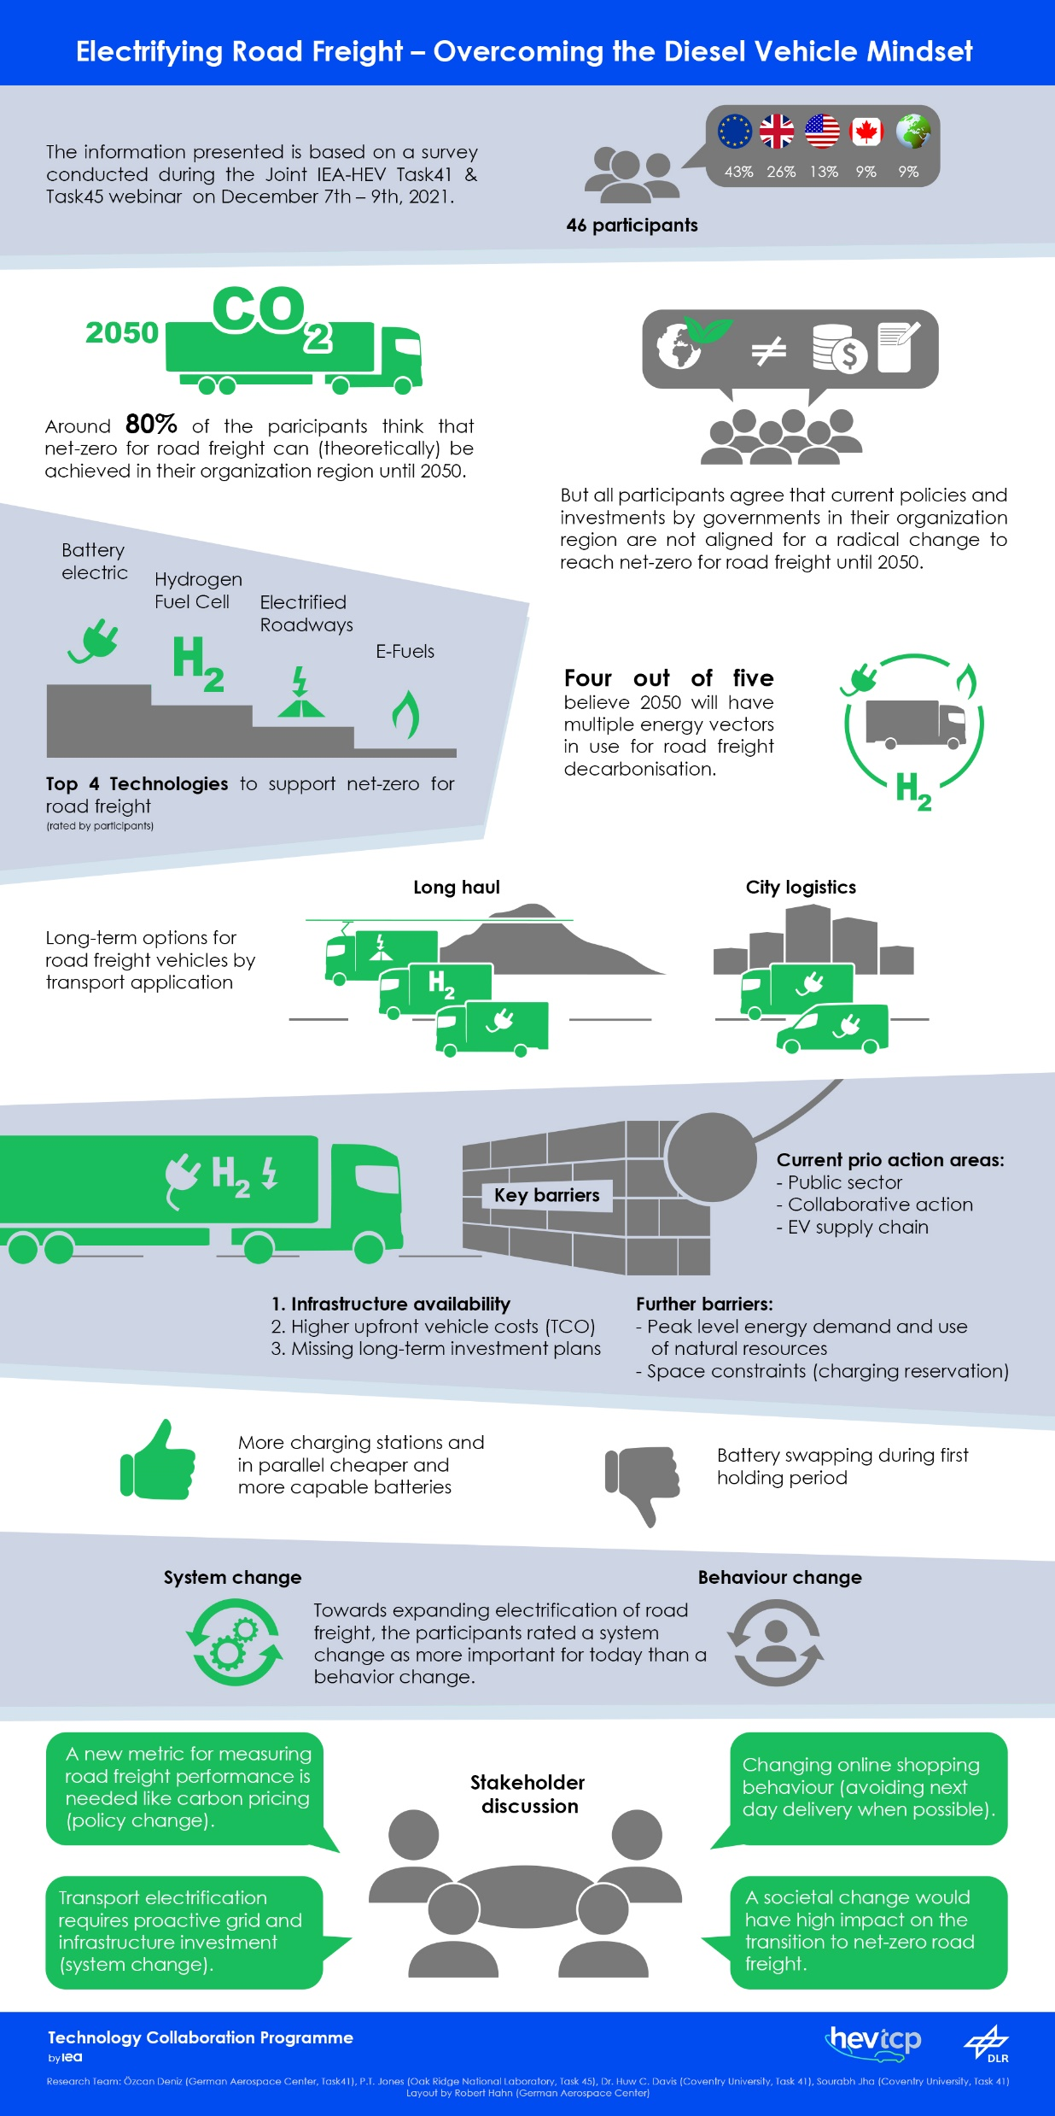
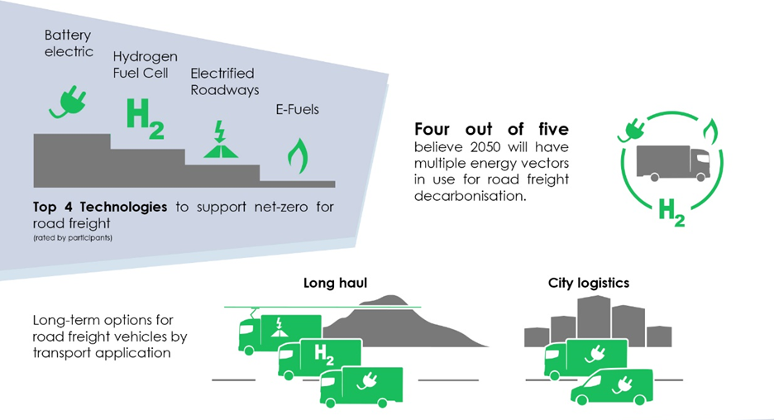
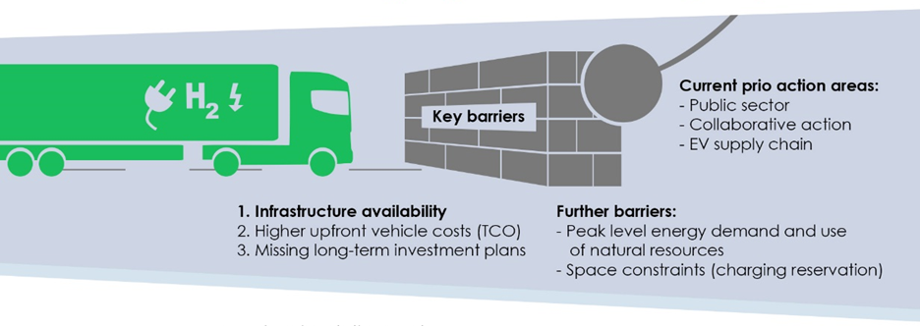
Current discourse in road freight transport in terms of climate change mitigation
Results of a workshop survey with international participants:
Technological options
Challenges
Source: IEA HEV-TCP TASK 41 Final Report

Slide 11

Comparison of different powertrain options for heavy-duty trucks - Efficiency losses
Renewable Energy (3 MW wind turbine with 2.000 h/year = 6 Mio. kWh)
 | E-Fuels with combustion engine | H2-combustion | Fuel Cell Electric | Battery Electric
Fuel production efficiency (well to tank) | 42% | 52% | 52% | 95%
vehicle efficiency (tank to wheel) | 40% | 38% | 52% | 74%
Overall efficiency (well to wheel) | 17% | 20% | 27% | 71%
Operated 40t trucks (250 days, daily 600km) | 11 | 13 | 18 | 46
Source: JEC Well-to-Tank report v5 and DLR analysis

Slide 12

Range anxiety for electric trucks in urban and regional transport mostly unfounded
For urban derlivery and regional distribution, range of BEVs are suitable to meet daily mileages
FCEVs can cover the higher daily mileages and hard-to-plan routes – especially in long haul transport
increasing energy density of Li-Bat. and Megawatt charging systems enables higher daily ranges for BEVs
urban delivery
regional distribution
Long-haul transport
Source: Special analysis of KBA statistics for commercial vehicles 2017

Slide 13
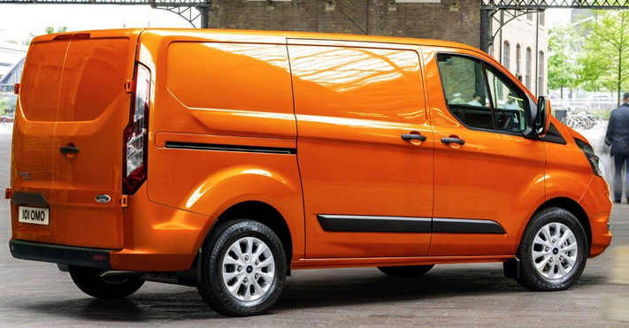
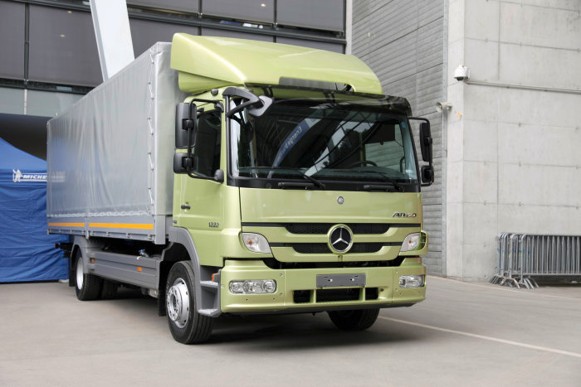
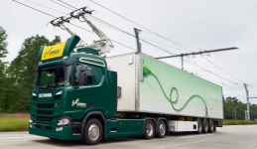
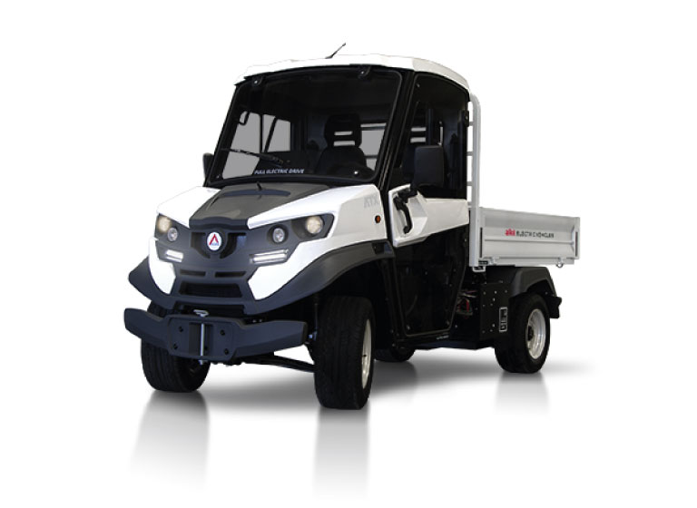
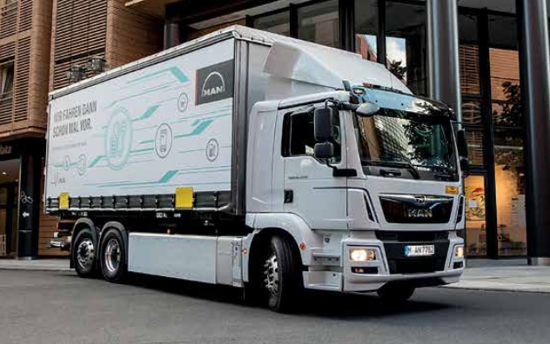
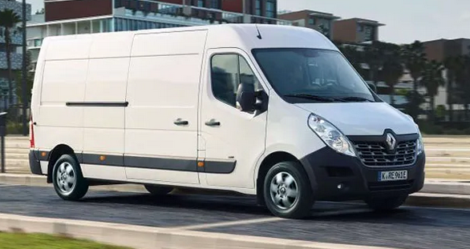
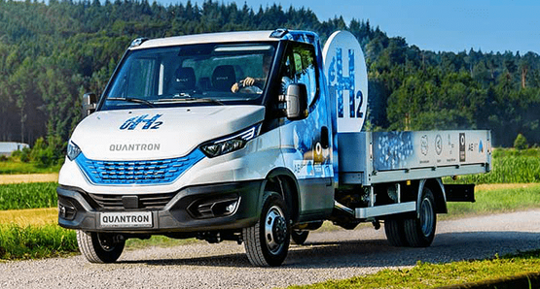
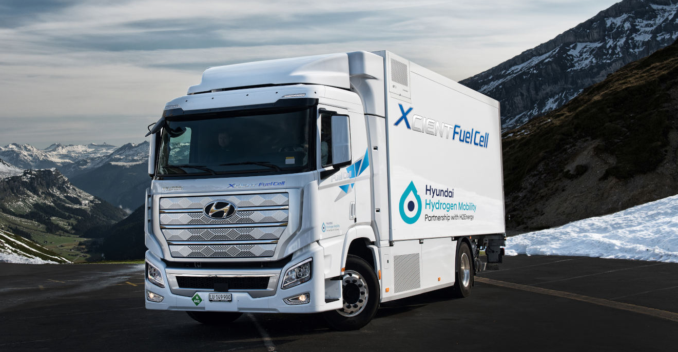
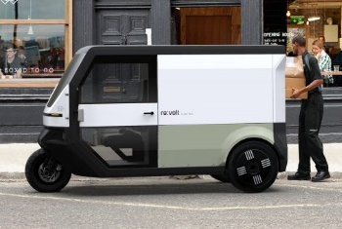
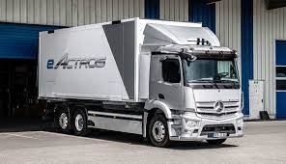
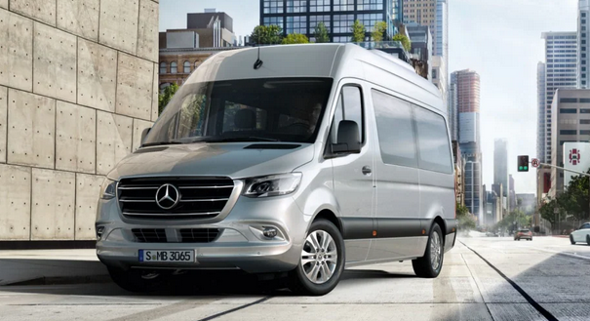
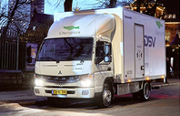
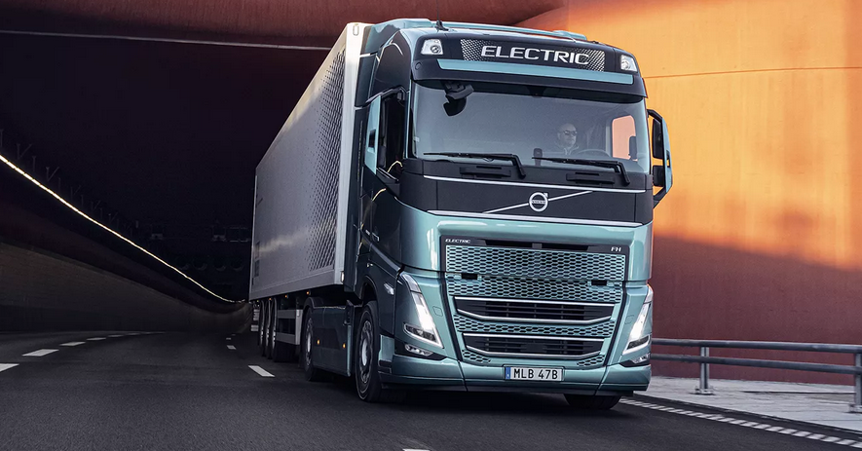
Model availability widens for electric freight vehicles in all segments
Pick-up trucks
(N1 category)
Vans
(N1 category)
Light
Articulated Trucks
(N2 category)
Heavy
Articulated Trucks
(N3 category)
Semi-trailer Trucks
(N3 category)
BEV
HEV
series
HEV
HEV
series
not available
BEV
project vehicle
SOP 2024
Ford Transit (PHEV)[4]
Mercedes-Benz Atego FHEV (7]
Scania R450 Hybrid [12]
FCEV
FCEV
FCEV
on sale in 2022
per order
Alke ATX 330E [2]
MAN eTGM [10]
small series
e-converted
SOP 2022
small series
Renault Master Z.E. Hydrogen [5]
Quantron Q-Light FCEV 120 [8]
Hyundai Xient Fuel Cell [13]
BEV
BEV
BEV
series
small series
SOP 2022
Clean Motion Re:volt [3]
Daimler eActros [11]
Mercedes-Benz eSprinter [6]
Fuso eCanter [9]
Volvo FE Electric [14]
Notes:
[2] https://www.alke.com/de-de/index.php
[3] https://cleanmotion.se/revolt/
[4] https://www.ford.de/service/ihre-mobilitaet/ask-ford/nutz-und-flottenfahrzeuge/nutzfahrzeuge-allgemein/ford-transit-custom-plug-in-hybrid-phev
[5] https://blog.renault.de/neues-von-renault-brennstoffzelle-fuer-kangoo-ze-master-ze/
[6] https://www.mercedes-benz.de/vans/de/sprinter/panel-van
[7] https://media.daimler.com/marsMediaSite/de/instance/ko/Atego-BlueTec-Hybrid-Hybrid-Lkw-beweisen-im-Praxiseinsatz-Alltagstauglichkeit-und-CO2-Kraftstoffeinsparpotenzial.xhtml?oid=9361912
[8] https://www.quantron.net/q-mobility/q-truck/q-light/
[9] https://www.electrive.net/2018/01/31/renault-trucks-bringt-2019-e-lkw-auf-den-markt/
[10] https://www.man.eu/de/de/lkw/alle-modelle/der-man-etgm/etgm.html
[11] https://www.mercedes-benz-trucks.com/de_DE/emobility/world/our-offer.html
[12] https://www.electrive.net/2018/12/06/ehighway-tests-bund-ordert-15-hybrid-lkw-bei-scania/
[13] https://www1.hyundai.news/de/unternehmen/hyundai-liefert-erste-xcient-fuel-cell-brennstoffzellen-lkw-aus/
[14] https://www.volvotrucks.de/de-de/trucks/trucks/volvo-fh/volvo-fh-electric.html

Slide 14
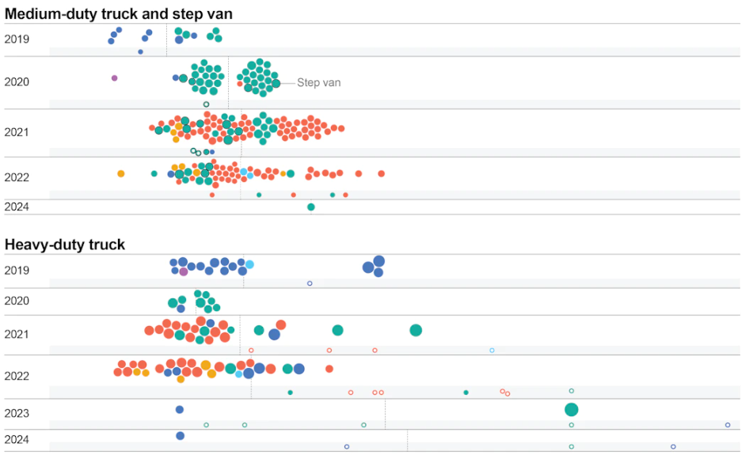
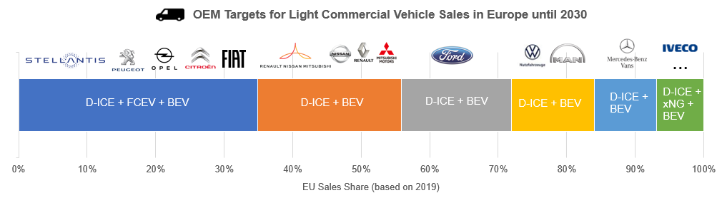
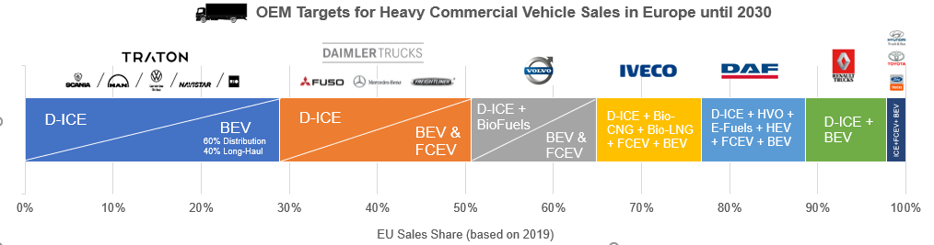

The number of battery-electric series models will rise in the future
2019-2024
2030
Current and announced zero emission commercial vehicle by type, release date and range, 2019-2024
The three largest truck manufacturer groups in Europe aim to equi at
least every second sold trucks with an electric powertrain by 2030
Source: IEA HEV-TCP TASK 41 Final Report
Source: IEA Global EV Outlook 2023

Slide 15
Comparison of the TCO structure of 40t semi-trailer tractor with different powertrains in long-distance transport
Today:
FCEV and BEV with high investment costs
Slight cost differences between H2-Storage-options for FCEV
After 2025:
TCO parity for FCEVs achieved from 2029 onwards
Investment cost will still be higher for BEV and FCEV than diesel trucks in 2030
Source: Own DLR analysis

Slide 16
Key factors to ramp-up zero-emission freight vehicles
Suitable policy framework
Availability of charging and refueling infrastructure
Reliable and efficient trucks
Purchase subsidies: 80% of the additional investment costs for vehicle and infrastructure procurement for BEVs and FCEVs are funded via the KSNI funding guideline (until 2026).
Road toll exemption for xEVs until 2026 and introduction of a CO2-based component in the toll calculation starting in 2024.
Vehicle tax exemption for xEVs until 2030
Special depreciation of xEV: 50% of the purchase in the first year

Slide 17
Outline
Current challenges and opportunities for decarbonizing road freight transport
Scenario analysis of the market potential of alternative powertrains in commercial vehicles: Results of the BEniVer* research project
Insight into DLR´s vehicle concept “U-Shift”
*Begleitforschung Energiewende im Verkehr Accompanying research on the energy transition in transport)

Slide 18
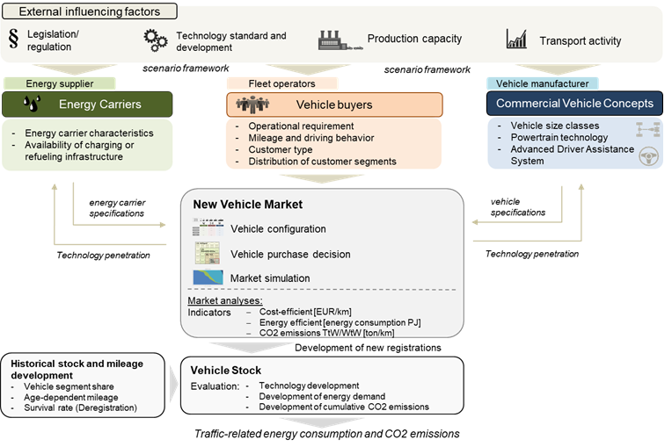

Scenario and market analysis software for simulating future commercial vehicle markets in Germany until 2050
Scenario assumption
Agent-based Modelling
Simulation of the market potential of alternative fuel and powertrain options in new vehicle market
Assessing the diffusion of energy and powertrain technologies in road traffic
Source: Özcan Deniz 2022 Development of a scenario model for the simulation of the technology diffusion in the commercial vehicle market in Germany, 35th International Electric Vehicle Symposium and Exhibition (EVS35) Oslo, Norway, June 11-15, 2022 https://elib.dlr.de/187389/1/EVS35-340138.pdf

Slide 19

Scenario definition
Scenarios focusing on different technology options for the transport sector to meet climate targets.
Considered scenarios:
Technology Scenarios (GHG reduction of 100% until 2045)
Reference Scenario
(GHG reduction of 80%)
E-Fuels
Hydogen
Direct Electrification

Slide 20
Main scenario assumptions to reach GHG-neutrality in 2045“scenario
  EU average CO2 emission targets for LDV 0 g/km in 2035 and for HDV 0 g/tkm in 2040
  CO2 price for fuels: 2030: 100 €/ton CO2; 2045: 300 €/ton CO2
  Forecast vehicle mileage: 2020: 83.5 billion veh-km; until 2030: +10%; until 2050 +20% compared to 2020
  Crudie oil price: 2020: 36€/bbl; 2030: 69€/bbl; 2050: 85€/bbl
 | E-Fuels | E-Mob | H2-Mobility
EU Fleet CO2 Emission regulation | Crediting of E-Fuel Blends in EU CO2 fleet emission regulation | - | -
Toll | - | Toll exemption for BEV and FCEV until 2035
Vehicle tax | - | Tax exemption for BEV and FCEV until 2035
Energy tax | Tax exemption for E-Fuels until 2035 | - | Tax exemption for H2 until 2035
Energy carrier price | Syn Diesel: 3,09 €/l (2030) | Electricity: 0,30 €/kWh (2030) | Hydrogen: 5,67 €/kg (2030)
Technology development | ICE (BTE 55% in 2030) | Lithium-Ion Bat system min price: 91€/kWh | Min. prices: Fuel Cell System 121€/kW, H2-Tank-System 322€/kg
Infrastructure availability | - | Roll-out Megawatt-Charger (800kW) until 2030 | Roll-out public H2-Station (CH2) until 2030

Slide 21
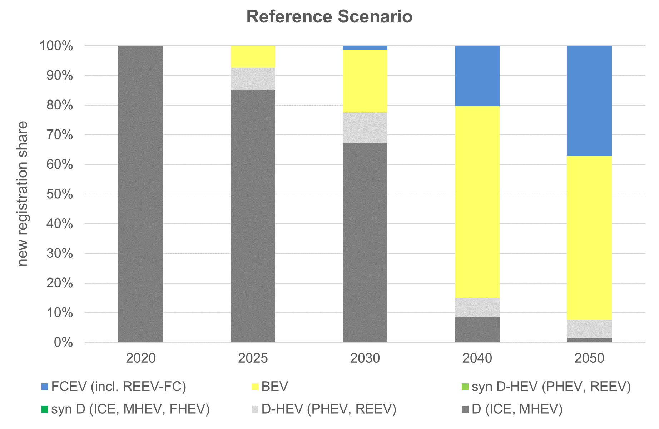
Reference scenario
Market potential for alternative powertrains
Status of new registrations 2020*:
96% ICE-D
2.7% xEV (9350 BEV, 947 HEV)
2020 - 2030:
Focus on incremental technology development of ICE-D
Parallel ramp-up of xEVs
First FCEV in heavy duty segment (simulation agents with higher mileage)
2030 - 2050:
Strong ramp-up of BEVs in light duty vehicle segment and after 2040 also in heavy duty segment
FCEV in particular for long-haul transport

Slide 22
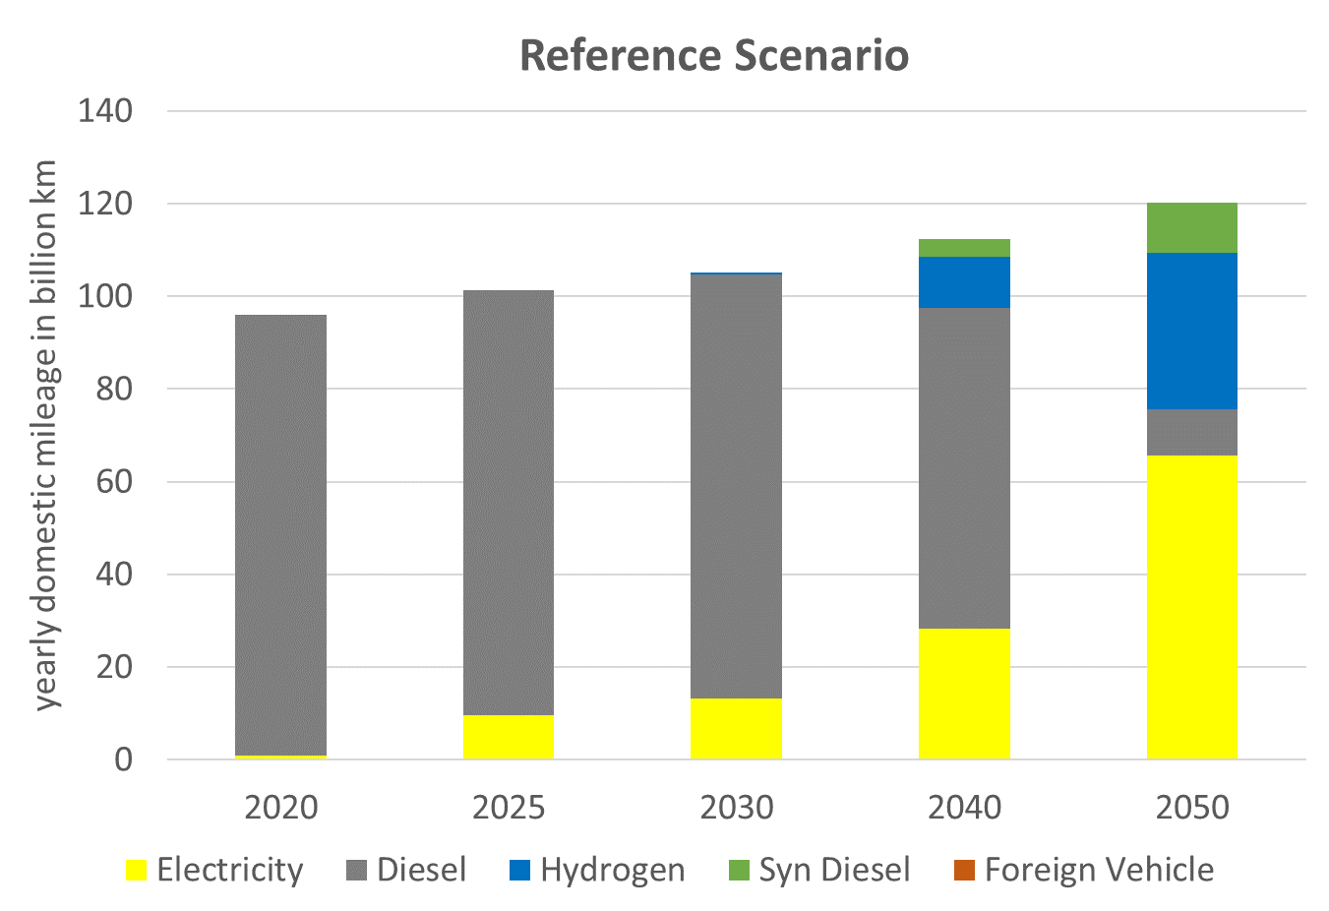
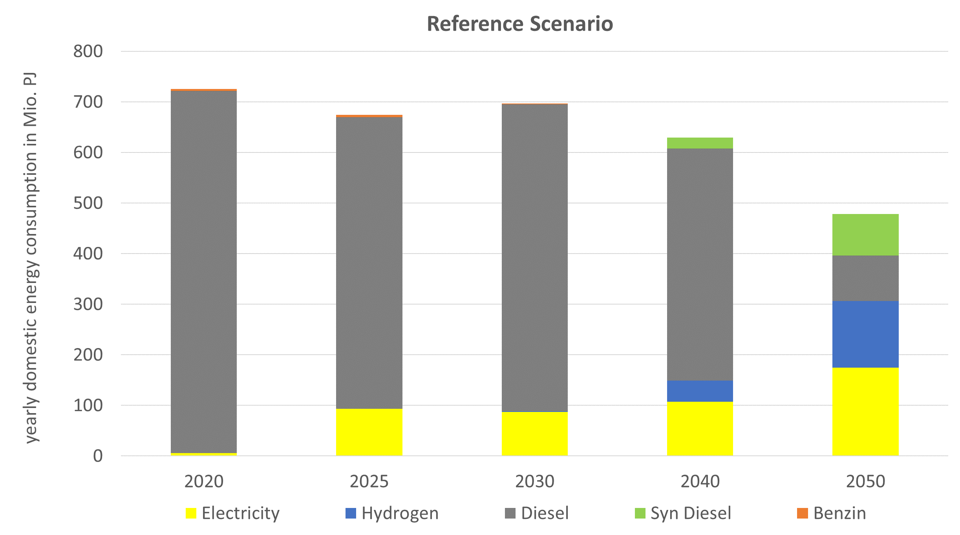
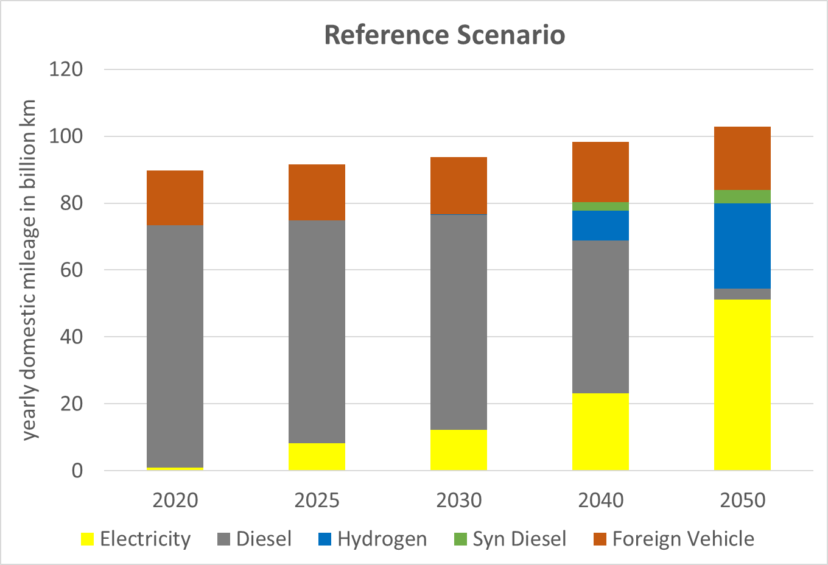
Reference scenario
Development of mileage and energy consumption of fleet vehicles
Transport performance in billion vkm
Final energy demand in Mio. PJ
Share of electric mileage =13.2%
(target: 33%)
- 29.9% compared to 2005
(Taget: -40%)
Total mileage of road freight transport 97.7 vehicle kilometres in 2020
Energy consumption domestic LDV 261.8 PJ + HDV 445.6 PJ in 2017 = 707.4 PJ
Reduction target: About one third of the mileage in heavy road freight transport should be covered electric or on the basis of electricity-based fuels by 2030.
Germany has committed to reducing final energy consumption in transport by 10 % by 2020 and by 40 % by 2050 compared to 2005.

Slide 23
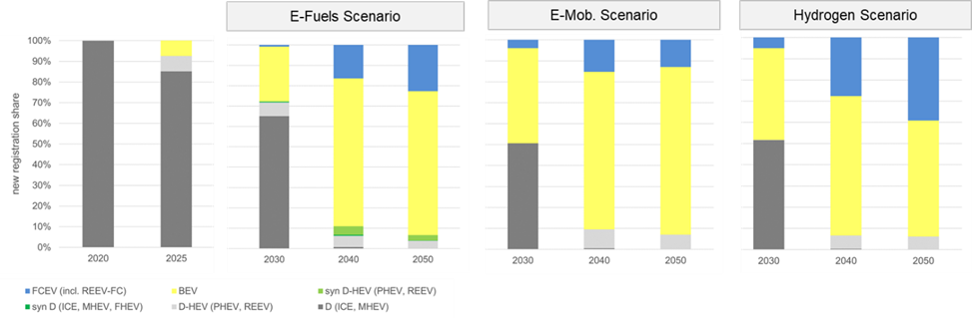
Sceanrio comparison
Market potential of alternative powertrains
BEV as dominate powertrain post-2030 – especially for Light Duty Vehicles
Market potential of Fuel Cell Electric Heavy Duty Vehicles in long haul operation
Limited adoption of conventional vehicles fueled by E-fuels
Ref-Scenario

Slide 24
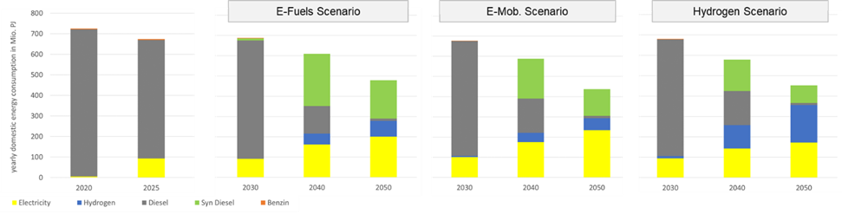
Sceanrio comparison
Development of the final energy demand
Increasing share of BEVs while total mileage increases, reduce final energy demand in all scenarios
The “Energy Efficiency Target for 2050” is met at closest by the Electric Mobility scenario
Reducing final energy consumption by 40%
- 29,82%*
- 35,9%*
- 33,7%*
Peak demand for electricity in 2050: approx. 55 TWh
Peak H2 demand in 2045: approx. 48 TWh

Slide 25
Conclusion of the scenario analysis
Direct electrification of trucks (BEV) shows the highesr market potential in all vehicle segments
  Essential for the market ramp-up of BEVs are the current funding of the purchase price, toll exemption and decreasing production costs for lithium-ion batteries
Fuel cell electric trucks shows market potential for heavy long-distance applications where range and payload of BEVs do not meet user requirements
  However, the market volume of these segments are low, which is why economies of scale for fuel cells are lower too
The Ram-up of a megawatt charging and hydrogen filling stations (on long-distance roads) are simultaneously necessary with the electric vehicle adoption
CNG/LNG show low market potential - simultaneous, multiple investments in R&D and infrastructure not beneficial
E-fuels as an blend in diesel fuel may be necessary for decarbonisation of fleet vehicle. The Potential depends on dynamics of fleet renewal - rapid, early market penetration of BEVs reduces the potential
Limitation of the scenario analysis:
Predominantly technological potentials modelled
Shift potentials (to rail) or structural change in the industry/logistics associated with lower mileage

Slide 26
Outline
Current challenges and opportunities for decarbonizing road freight transport
Scenario analysis of the market potential of alternative powertrains in commercial vehicles: Results of the BEniVer* research project
Insight into DLR´s vehicle concept “U-Shift”
*Begleitforschung Energiewende im Verkehr Accompanying research on the energy transition in transport)

Slide 27
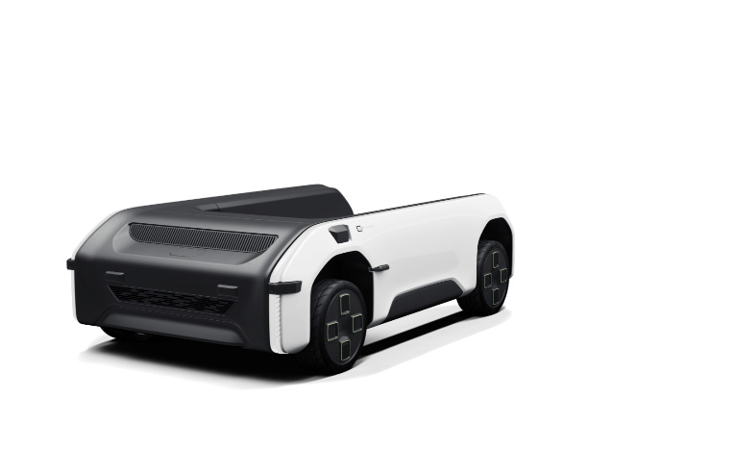
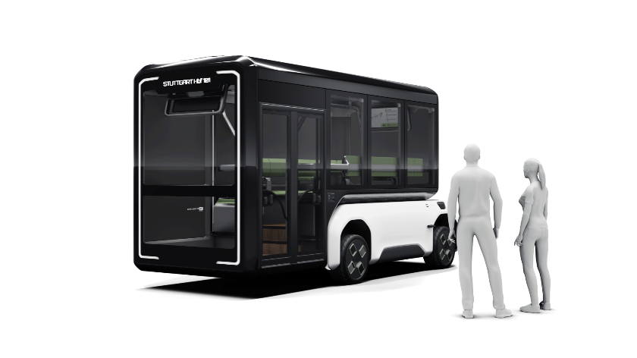
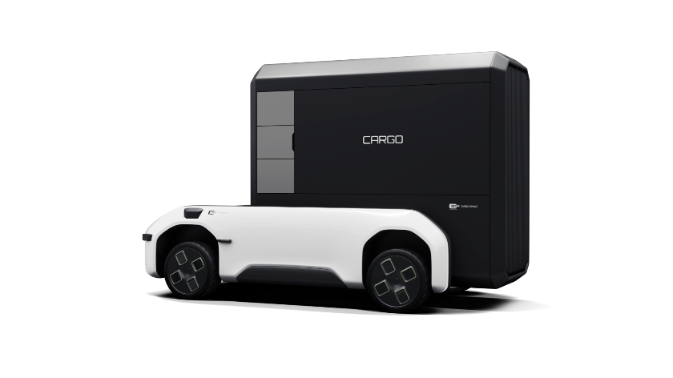
U-Shift - vehicle concept at a glance
A Major Shift
U-Shift project: Modularity leads to efficiency – and defines completely new possibilities in the transport of goods and people in an urban context.
Driveboard
Personal capsule
Freight capsule
Flexible transport of people or goods
Automated drive board with electric drive train
Automatic capsule change without operating personnel and without special infrastructure
Passenger capsule for public transport, 8 seats, integrated ramp for wheelchair/pram etc.
Goods capsule for 3 - 4 Euro pallets with a payload of 2,000 kg

Slide 28
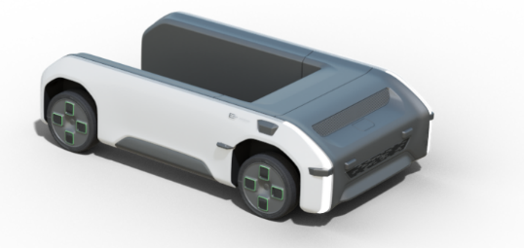
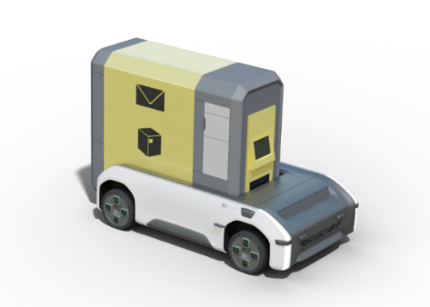
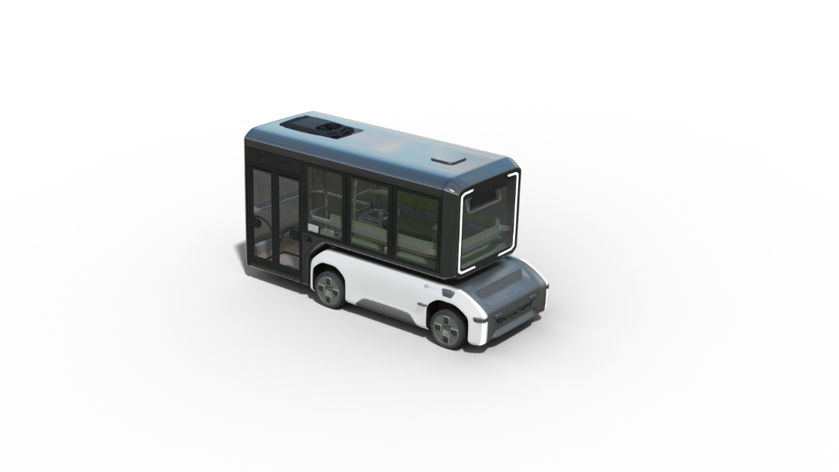
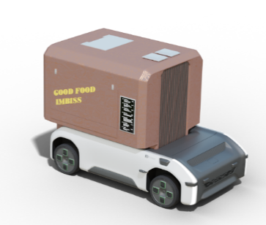
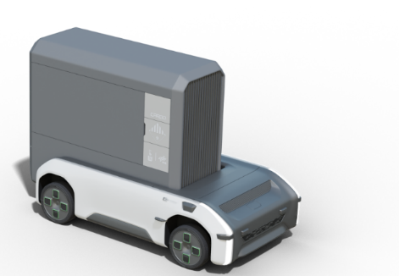
Characteristics of Driveboard + Capsules
Driveboard:
Standardised
Electrically driven
Integrated lifting function
High capacity, efficient use
Automated operation
„On-the-Road“Modularisation
Capsules:
Large number of variants for a wide range of applications (people / goods / service)
Individualised
Flexible, can be used as needed
"Simple", light, cost-effective
PUBLIC TRANSPORT:
Peoplemover, neighbourhood bus, large-capacity taxi, ...
City logistics:
CEP, last mile,
trade, craft, general cargo, ...

Slide 29
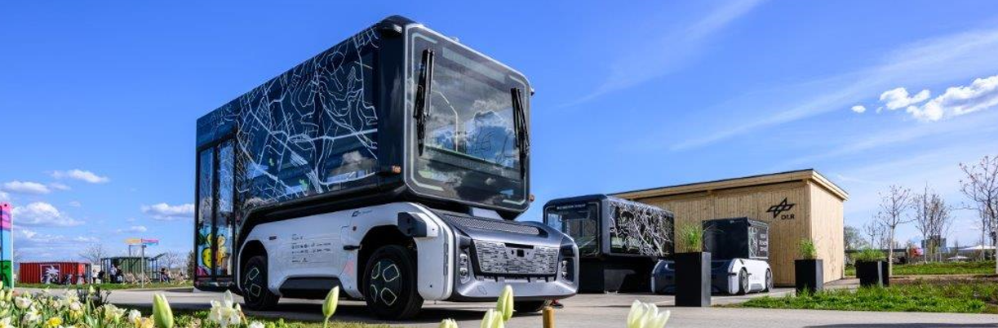
Visiting the U-Shift
Bundesgartenschau 2023
Mannheim (Spinelli)
Fr., 14. Apr. 2023 – So., 8. Okt. 2023

Slide 30
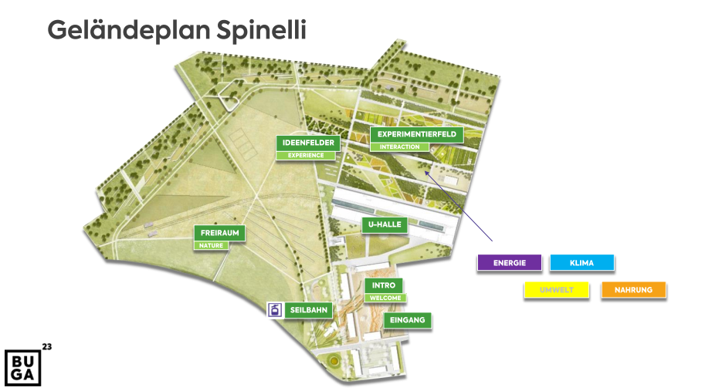
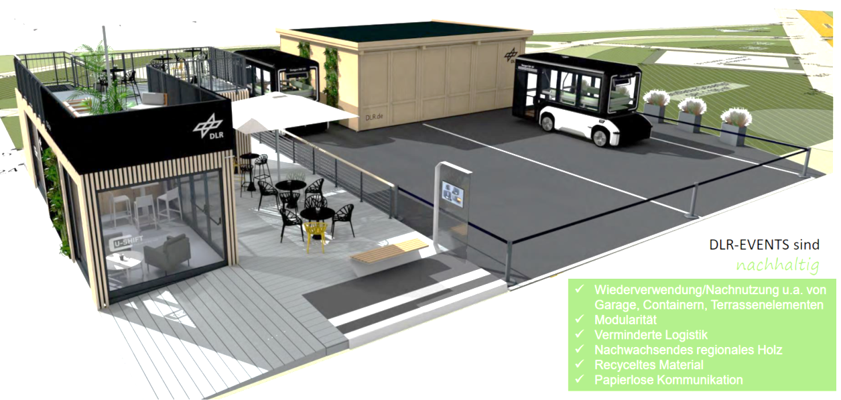
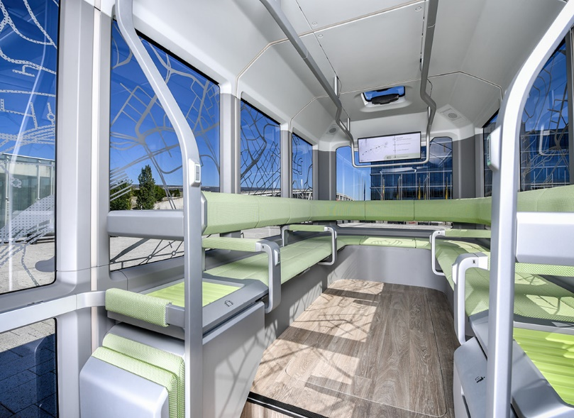
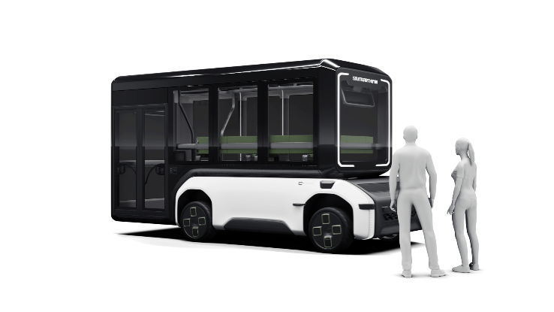
DLR U-Shift exhibition contribution
DLR U-Shift Pavillon
DLR Pavillon
Nordeingang
West-
eingang
U-Shift Fahrzeuge
Strecken-Optionen
Seilbahn
vom anderen
Neckarufer
Südeingang
Notes:
Auf Buga sind 2 Driveboards: „U-Shift I“ + „U-Shift IV“
Auf Buga sind zwei Kapseln: Kapsel „U-Shift I“ + „U-Shift IV
Auf Buga ist eine „Multi-Use-Plattform“

Slide 31
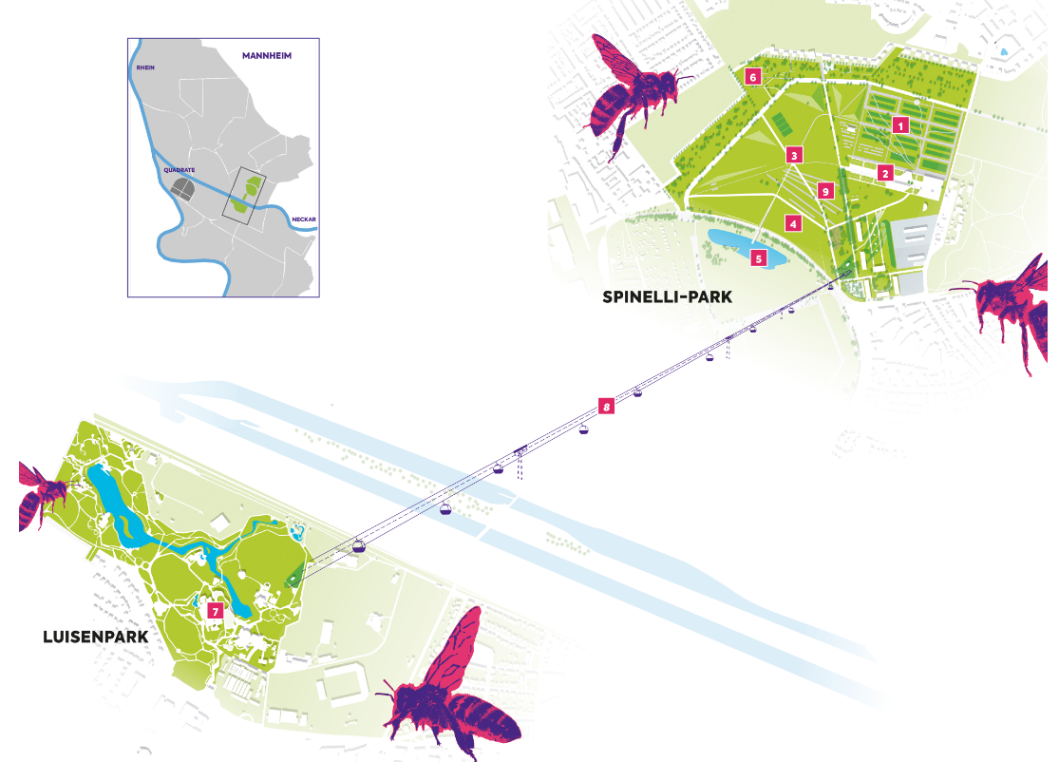
Tip for the way back from the BUGA - in case of departure by train
Use the cable car and leave the Luisenpark at the main entrance, from there to the main station.

Slide 32
U-Shift Video

Slide 33
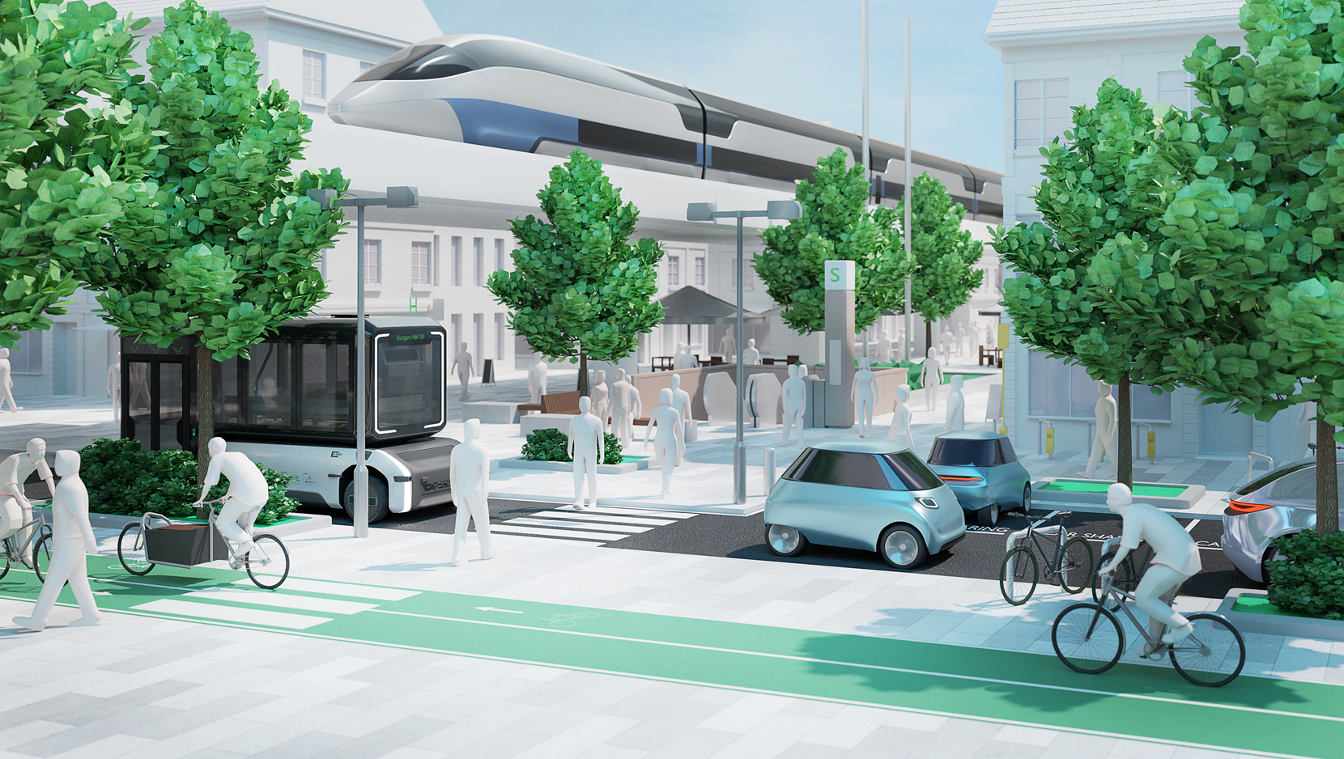
Any Questions?
Özcan Deniz
German Aerospace Center
Institute of Vehicle Concepts | Vehicle Systems and Technology Assessment
Stuttgart, Germany
Telephone +49 711 6862-8637 | oezcan.deniz@dlr.de

